Slide 1
Project 4

Slide 3
Project 4: Bare Minimum
Bronze contains a fully functioning CRUD.
Gold App has everything that we have implemented since week 1.
ALL available interactivity and navigation elements are functional, allowing correct user interaction and navigation of the content hierarchy.

Slide 4
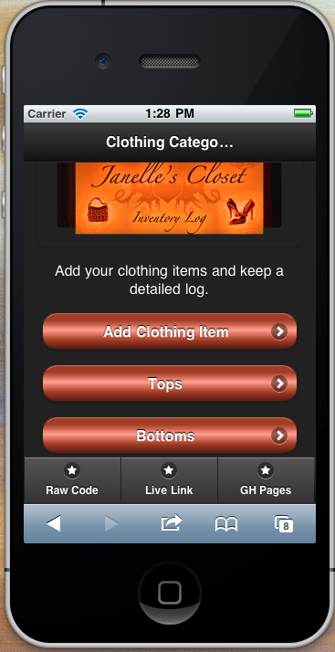
Project 4 Requirements
Color Selections:
Few Hues (colors), Many Values (tones or brightness). (pgs. 503 – 506)
Create a color palette, not a rainbow colored, “angry fruit salad” look.
Notes:
Janelle

Slide 5
Few Hues, Many Values

Slide 6
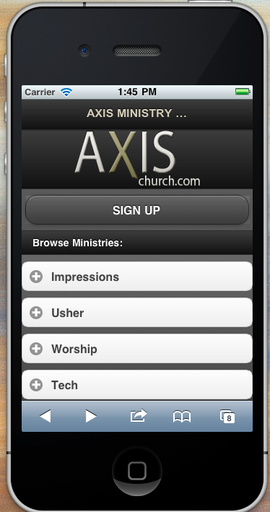
Project 4 Requirements
Deep Background
(pgs 499 - 502)
Content should appear to “float” on the background, not drown in it.
Notes:
Matt

Slide 7
Deep Backgrounds

Slide 8
Deep Backgrounds

Slide 9
Deep Backgrounds

Slide 10
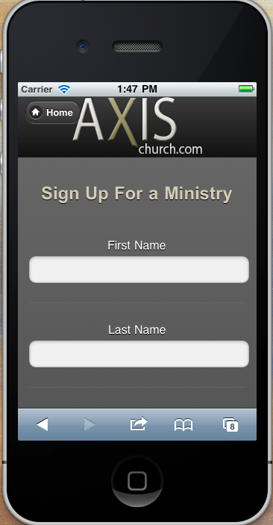
Project 4 Requirements
Streamlined Branding (pgs 257 – 261)
Must be in both your Gold and Bronze app
Notes:
Matt

Slide 11
Resources
Few Hues Many Values
Qunice - Few Hues
Color Value and Hue
Hub_and_Spoke UI Patterns
Color W3 Schools Colorpicker
Deep Background UI Patterns - Deep_Background

Slide 12
Extra Credit – each item is worth 5 points. Total possible points = 10!

Slide 13
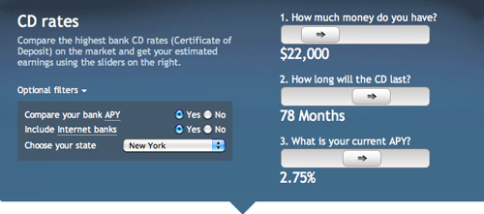
Project 4 Above and Beyond
Responsive Disclosure (pgs 179 – 182)
http://www.google.com/imgres?q=responsive+disclosure&um=1&hl=en&sa=N&biw=1115&bih=621&tbm=isch&tbnid=00npnzBBYQRqkM:&imgrefurl=http://uxdesign.smashingmagazine.com/2009/12/08/principles-of-effective-e-commerce-search/&docid=e8Am0pjEavWuIM&imgurl=http://media.smashingmagazine.com/wp-content/uploads/images/effective-e-commerce/mybanktracker-e-commerce.jpg&w=500&h=221&ei=v2LBTquoLoSKgweVtunbBg&zoom=1&iact=hc&vpx=435&vpy=308&dur=57&hovh=149&hovw=338&tx=175&ty=90&sig=111690504542132625750&page=1&tbnh=78&tbnw=176&start=0&ndsp=16&ved=1t:429,r:7,s:0

Slide 14
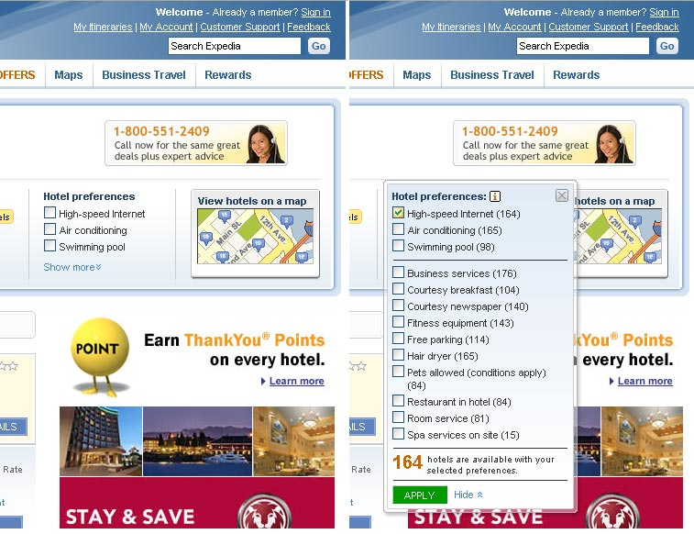
Responsive Disclosure (pgs 179 – 182)
http://quince.infragistics.com/Patterns/Responsive%20Disclosure.aspx#Examples

Slide 15
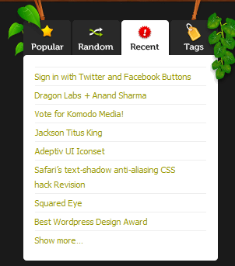
Project 4 Above and Beyond
Module Tabs (pgs 155 – 159)
http://www.smashingmagazine.com/2009/06/24/module-tabs-in-web-design-best-practices-and-solutions/
http://www.google.com/imgres?q=module+tabs&um=1&hl=en&biw=1115&bih=621&tbm=isch&tbnid=XkNoEOqYPNDhGM:&imgrefurl=http://www.smashingmagazine.com/2009/06/24/module-tabs-in-web-design-best-practices-and-solutions/&docid=iwCQxXurOr1b0M&imgurl=http://media.smashingmagazine.com/wp-content/uploads/images/module-tabs/komodo-media.gif&w=302&h=343&ei=gGzBTuLWI4T-ggfK2cSNBw&zoom=1

